Slide 1
Redox ratio imaging of intestinal organoids using 2-photon microscopy
Presented by:
Rishika Khanna, Olivia Radek, Quinton Pham, Gaurav Gomber

Slide 2
INTRODUCTION AND BACKGROUND

Slide 3
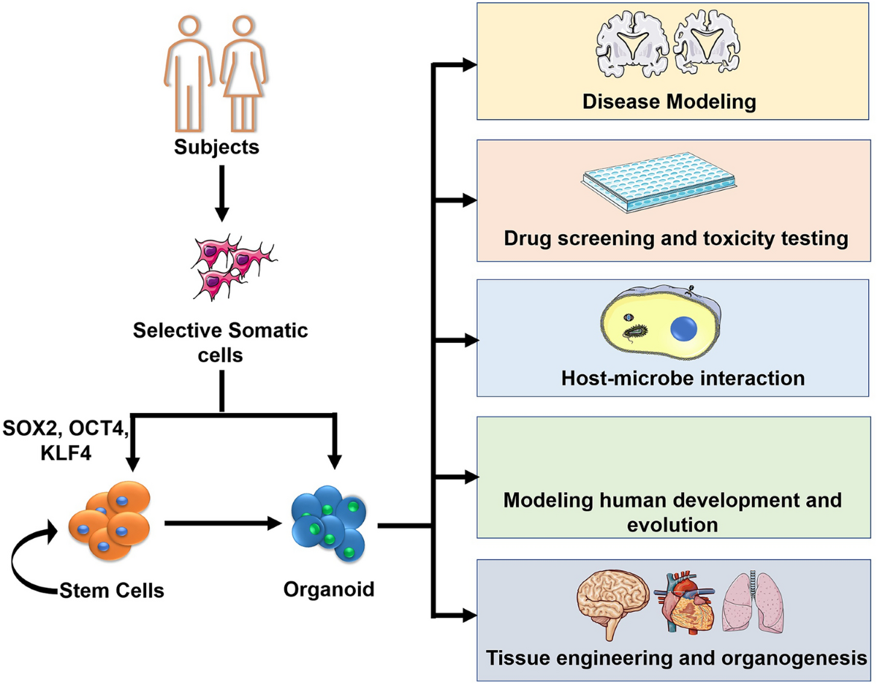
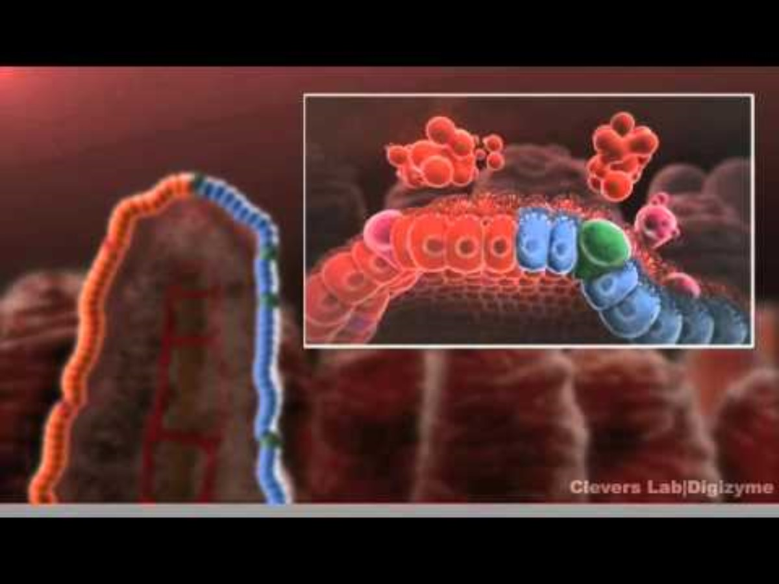
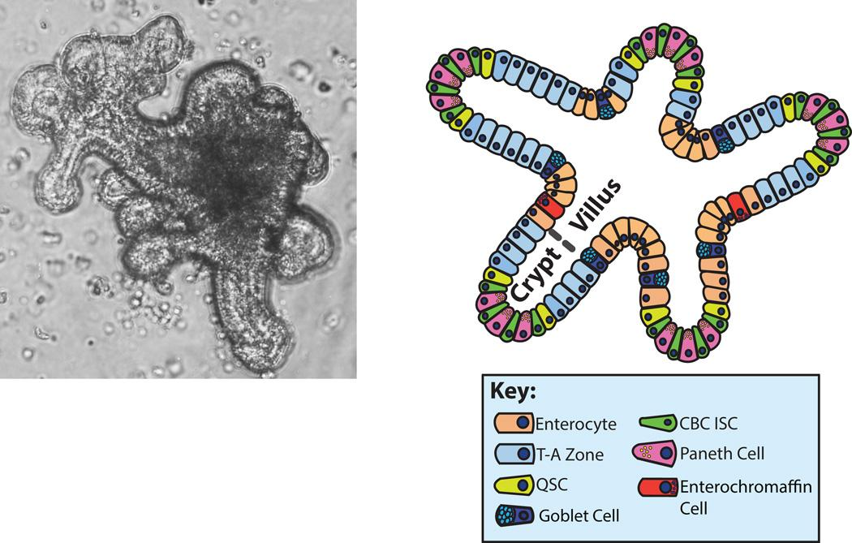
INTESTINAL ORGANOIDS
Two photon microscopy allows for high-resolution imaging of complex tissue, such as organoids.
Organoids are 3D cell cultures derived from stem cells that can serve as physiologic and anatomic models for specific tissues or organs in the human body.
Compared to cell cultures, organoids provide a more accurate microenvironment to mimic the actual organs and is faster and have high throughput than in-vivo models
Notes:
Gaurav
The specific organoid of interest in our experiment are intestinal organoids, which mimic the lining of a human small intestine Each organoid is composed of multiple villi, at the base of which is a crypt
At the base of the villi are located Crypts which are the home of stem cells in the intestinal tract. Cells are constantly produced by the stem cells at the base of the crypt. The daughter cells rapidly proliferate and exit the crypt moving up in the villus. Then go on to differentiate into different types of cells. After reaching the top they commit apoptosis
Stems cells at the base of the crypts continue to produce cells, which differentiate as they proliferate and move up the villi
At the top of the villi, these cells undergo controlled self-destruction, or apoptosis

Slide 4
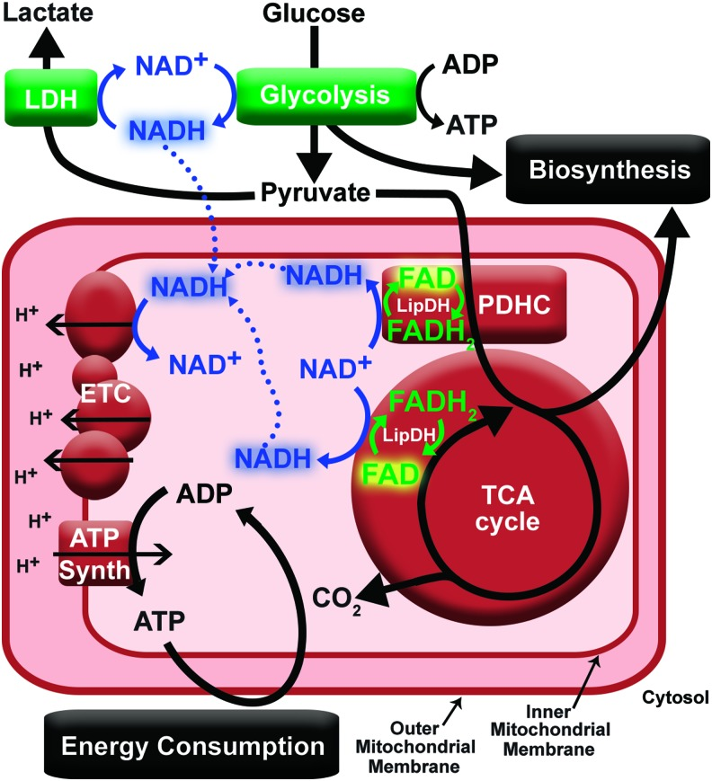
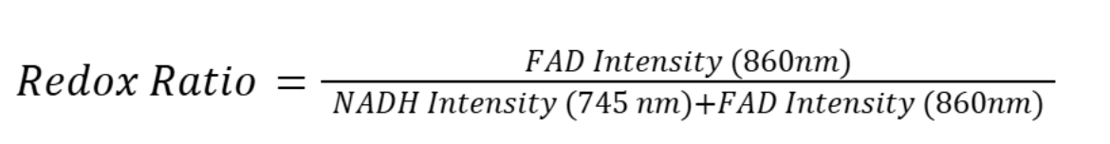
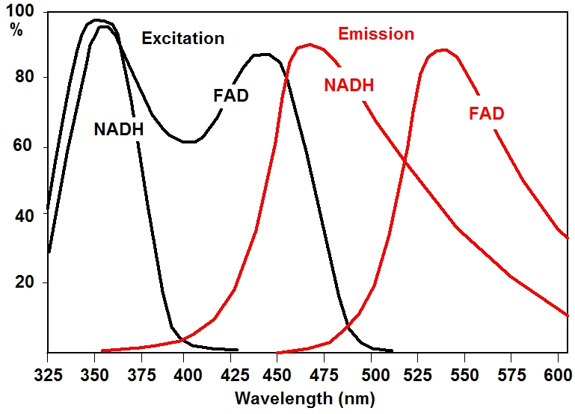
REDOX RATIO IMAGING
Metabolic activity can be quantified by the autofluorescence of NADH and FAD, coenzymes used in cells for metabolic processes like glycolysis and oxidative phosphorylation
A high redox ratio indicates predominance of oxidative phosphorylation, which suggests active metabolic processes and high energy production
A low redox ratio reflects glycolysis-dominant metabolism, suggesting lower energy production
Many human cancers emerge in epithelial tissues, and it is a well-studied phenomenon that cancer incidences are linked to alterations in cellular metabolism. Thus, getting information on the metabolic state during early stages of cancer can increase diagnosis speed and accuracy
Role of NADH and FAD in cellular metabolism
(From Kolenc OI et al. ,2019, Antiox. Redox Signal)
Notes:
Gaurav

Slide 5
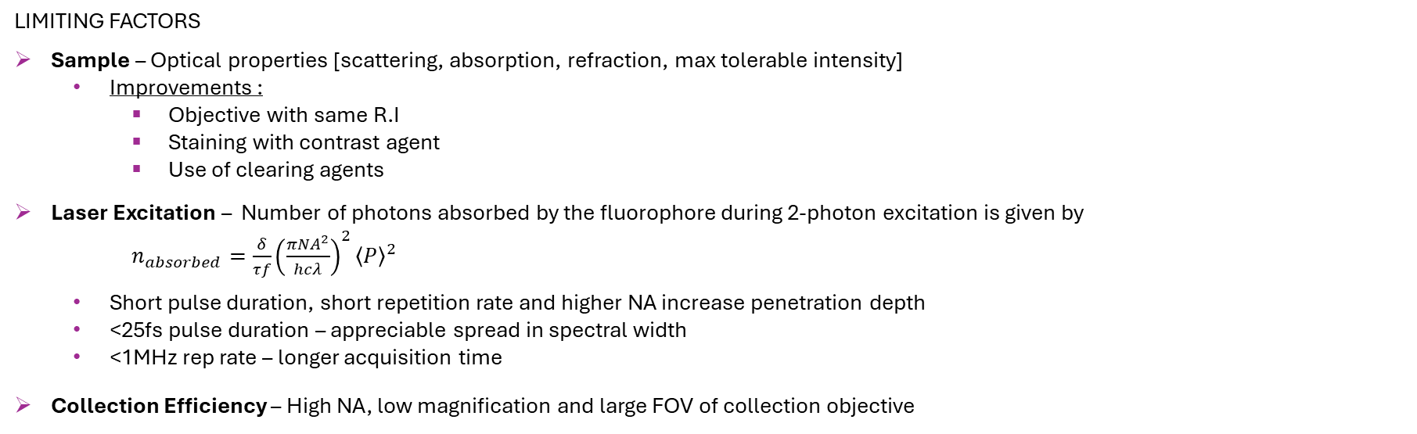
DEEP IMAGING IN TISSUES AND ORGANOIDS
Fundamental depth limit
Scattering helps to deliver more light to objective
Absorption becomes limiting factor
Requires higher acceptance angle & large front aperture
Photons that first travelled to opposite direction have more chance of backscattering
Photons will be multiple scattered and enter objective at steeper angles
Notes:
Rishika
With two-photon absorption cross-section δ, laser repetition rate f , laser pulse duration τ, laser wavelength , average power , numerical aperture of the objective (NA), Planck’s constant h, and speed of light c.

Slide 6
METHOD

Slide 7
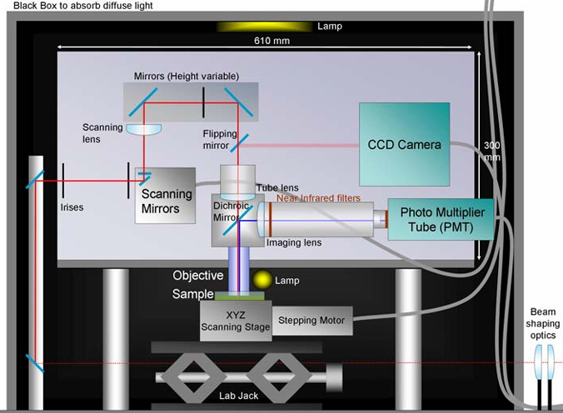
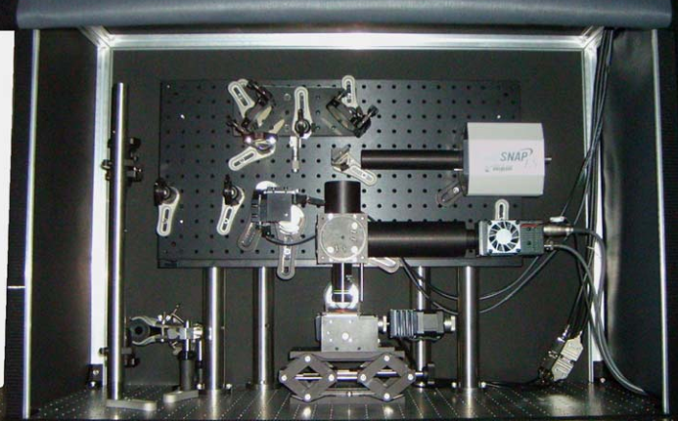
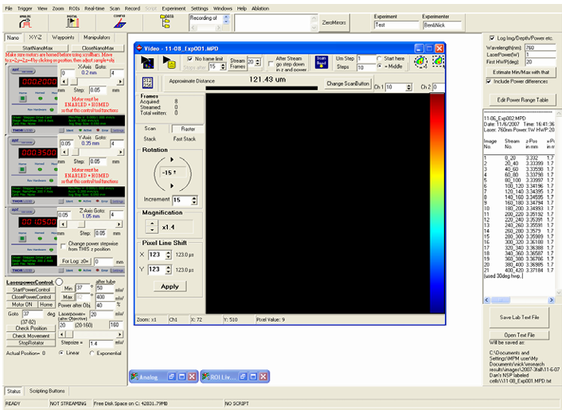
2 PHOTON IMAGING SETUP
Resolution
2” mirrors
PSF measurement of 100 nm fluorescent beads excited at 920 nm
Radial FWHM – 550 nm
Axial FWHM – 2300 nm
20% power transmission @ 745 and 860 nm
Manual HWP for power control
100 fs, 80MHz
Laser Source:
Ti: Sapphire “Mai-Tai laser” from SpectraPhysics
710-920 nm
Spectral pulse FWHM: 8nm
100fs
Objective:
Olympus 20x, 0.95 NA
2mm working distance
Back aperture 17mm
XLUMPLF
Controlling Software
Open-source software package: MP Scope
FOV: 340 um, 512x 512 pixels
Frame averaging - 8
Scanning Mirrors:
Galvo-Galvo Cambridge technology
Scanning angle ±20⁰
Diameter 6mm
Sample stage:
3-axis Nano stepper motors. 4mm travel, 25 nm resolution
Velocities: 1-2.5mm/s
Notes:
Rishika
Pulse duration is 100fs and repetition rate (frequency) is 80MHz. Tunable wavelength. Epi-configuration. Adjustable detection using flip mirror to direct the brightfield light to CCD camera for positioning of sample and fluorescence emission collection in PMT

Slide 8
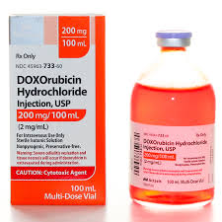
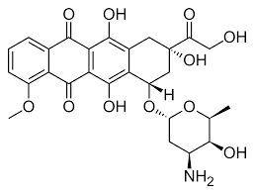
SAMPLES
Image Analysis Pipeline
2 control organoids
Frame Averaging
1 Positive control - DMSO
Background subtraction
1 Treated organoid - DOX
Image
Processing
Day 6 organoids cultured from Canine small intestine epithelial cell lines
Alignment and Noise reduction
Intensity Normalization
Redox Ratio Calculation
Popular and generic chemotherapy drug known to have serious side effects including gastrointestinal toxicity
Analysis and Results
Dox treatment
0.3 µM prepared in DMSO
Notes:
Olivia
Get the average intensity image by averaging the 8 frames in each FOV.
Background Subtraction: Use a region of interest (ROI) with no signal (e.g., background area in the image) to subtract background intensity from both 755 nm and 860 nm images.
Alignment adjustment between the 2 channels: Align the 755 nm and 860 nm images to correct for any spatial shifts or distortions due to the scanning system. Use image registration techniques (e.g., rigid or affine transformation) if required.
Noise Reduction: Apply median filters to reduce noise in each FOV while preserving the signal.
Intensity Normalization: Normalize the intensity of each pixel in the image with the corresponding power at that z step (Indicated in the naming of the file – See the NOTE below)
**NOTE:
The laser power mentioned in the naming of each file is the power measured at the laser source. However, after the optical setup only a certain percentage of the initial power is transmitted at the sample. In our case this transmission was measured to be 20% for both the channels (745 nm and 860nm). So, during normalization use only 20% of power which is mentioned in the name
Inormalized=ImeasuredPower2
Redox Ratio Calculation
Perform following calculation to get Optical redox ratio for each pixel in the FOV:
Redox Ratio=FAD Intensity (860nm)NADPH Intensity 745 nm+FAD Intensity (860nm)
Analysis
Averaging across depth: Select specific ROI (at least 3) in each image and compute the mean/median redox ratio. Plot depth dependent changes by plotting redox ratio profiles across z stack.
Comparison between control vs DOX treated organoids: Can do 2 sample t-test to compare between the 2 groups
Qualitative visualization: Take max z project across the z stack in each folder, then do the normalization and Redox ratio calculation and then create a colormap (eg. Red to blue) for low to high redox ratio.
This will help in visualization and qualitative comparison between the control vs treated organoids

Slide 9
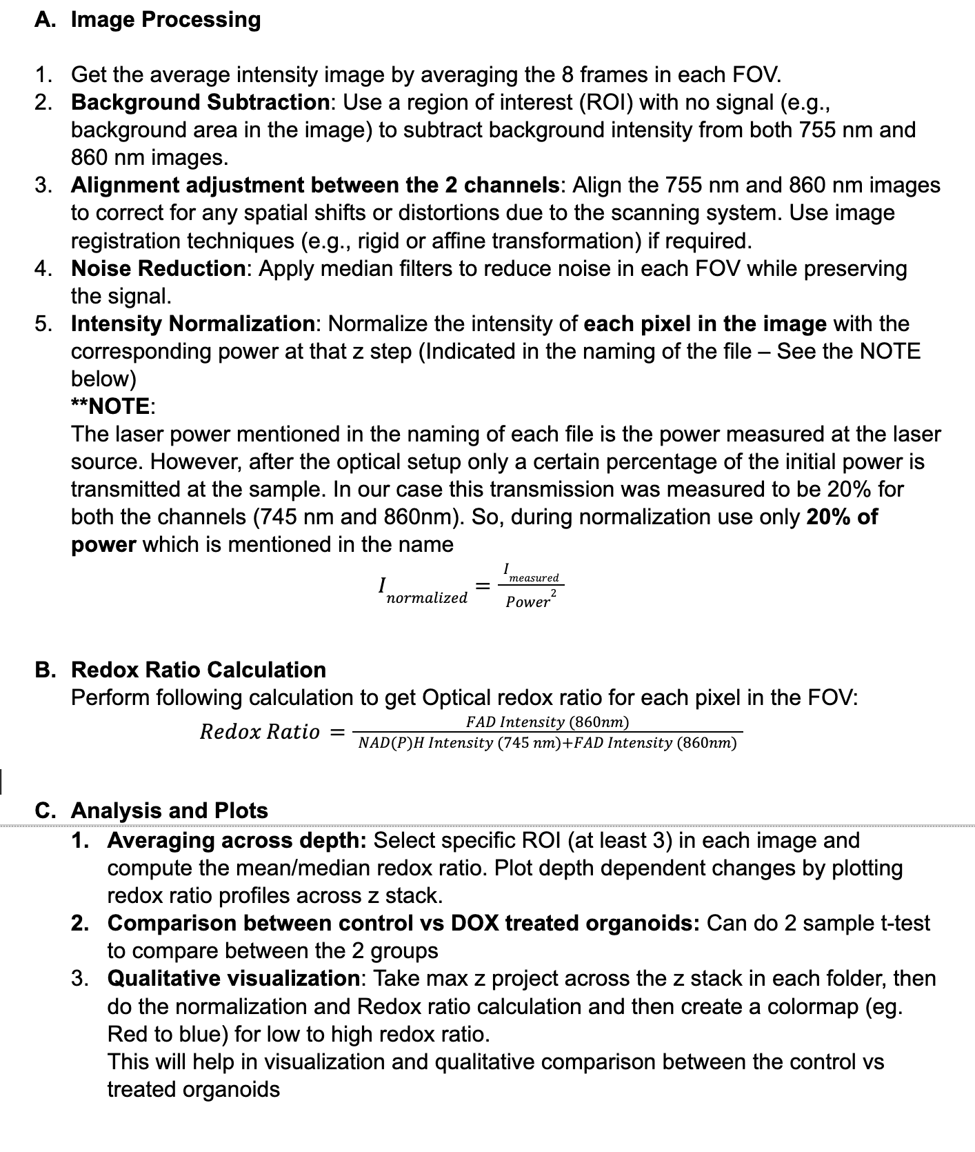
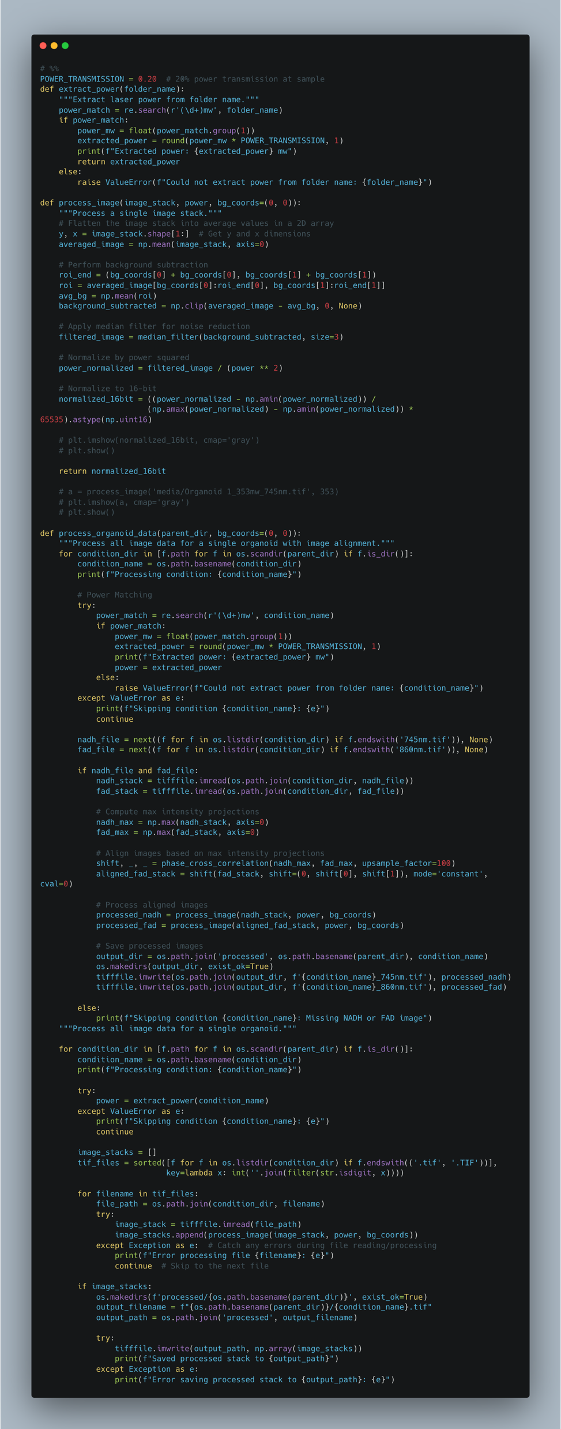
Document
to
Code
Notes:
Olivia

Slide 10
RESULTS, CONCLUSION AND FUTURE DIRECTIONS

Slide 11
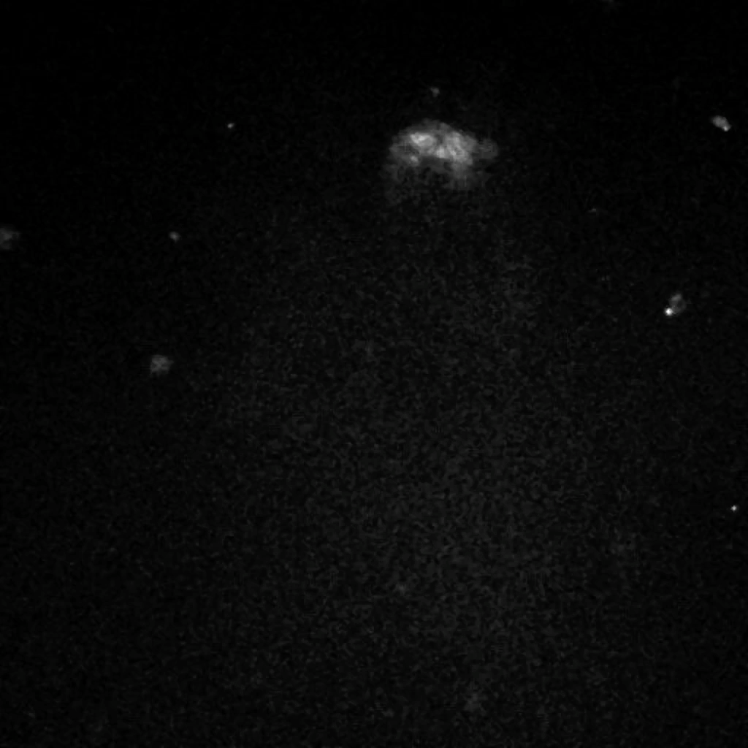
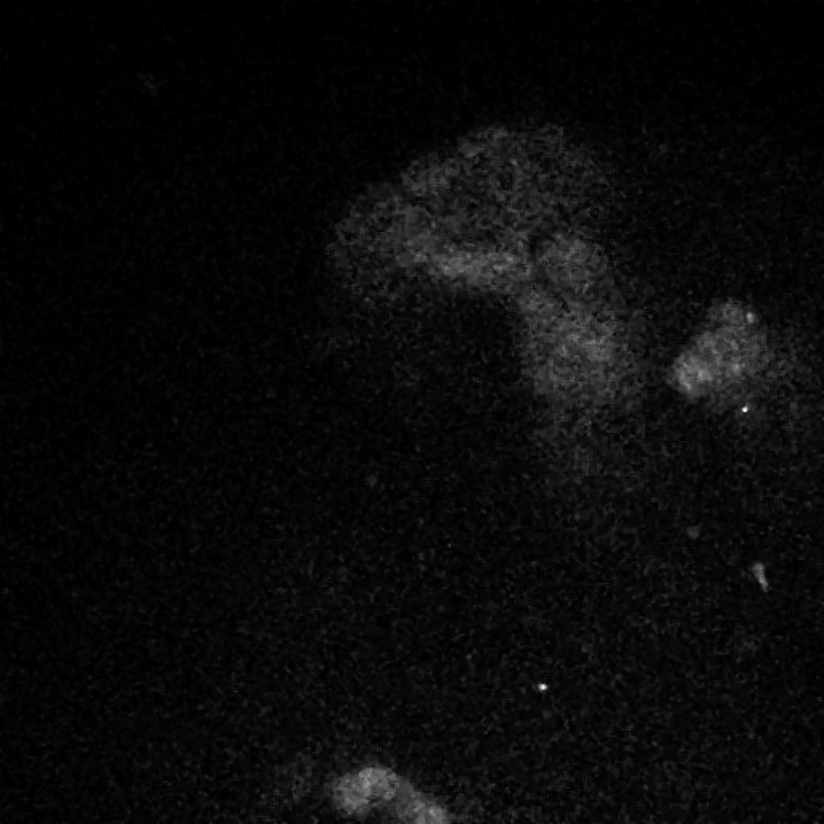
Untreated Organoid 1 Organoid 2

Slide 12
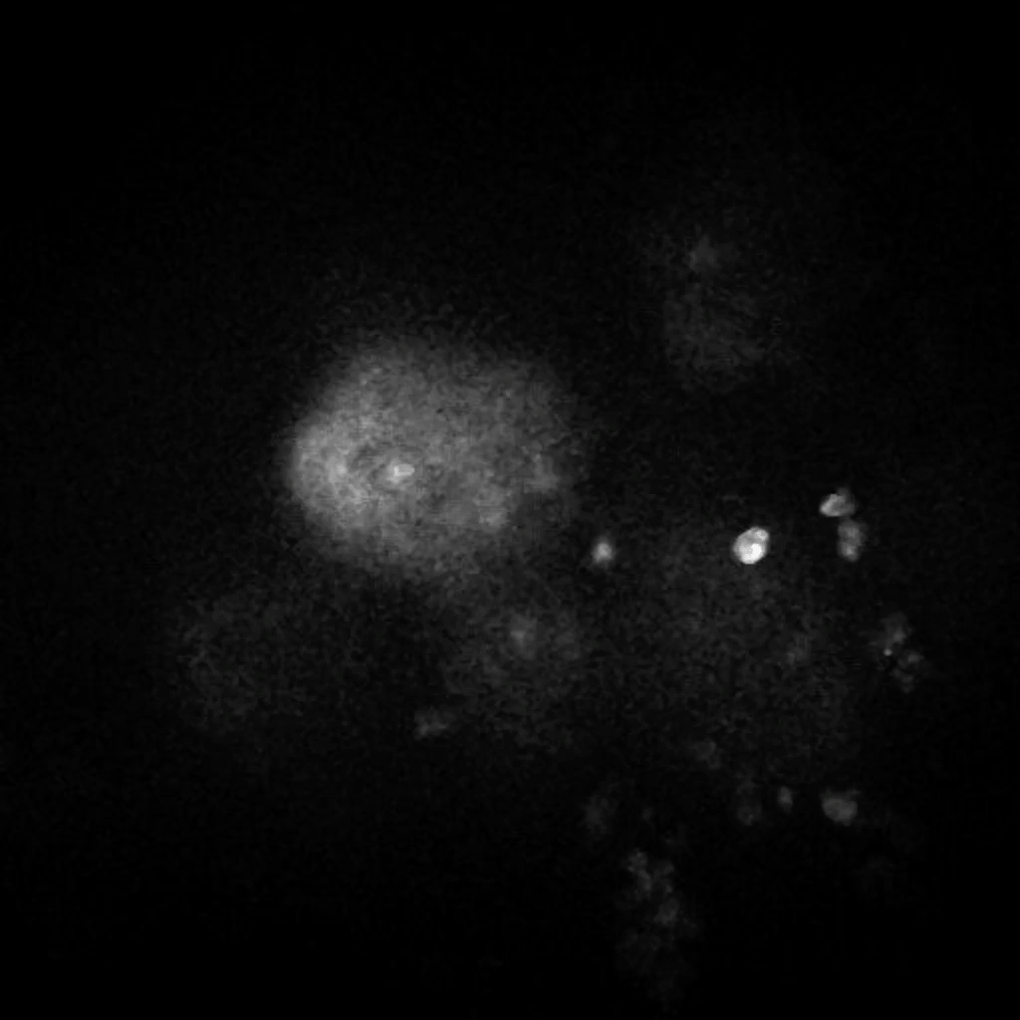
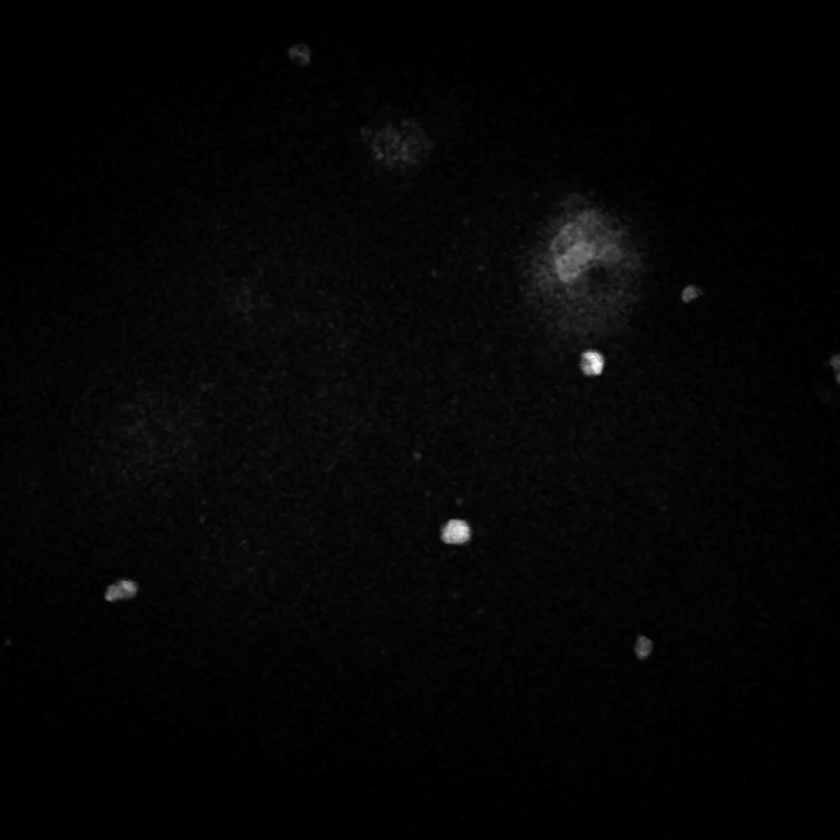
DMSO DOX

Slide 13
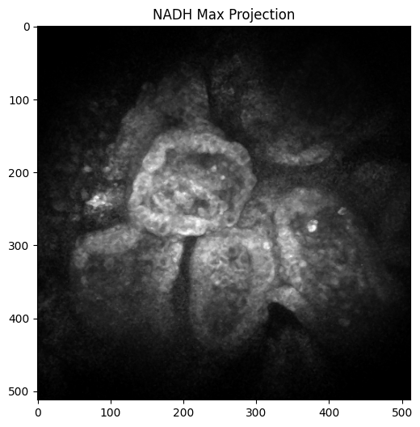
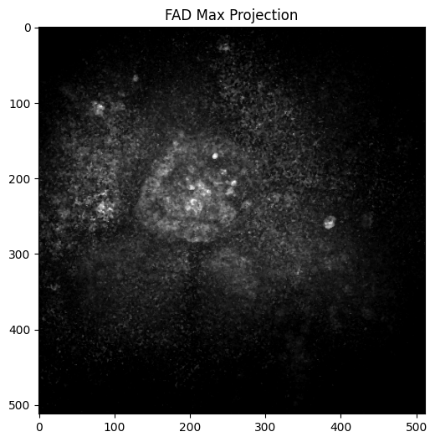
DMSO

Slide 14
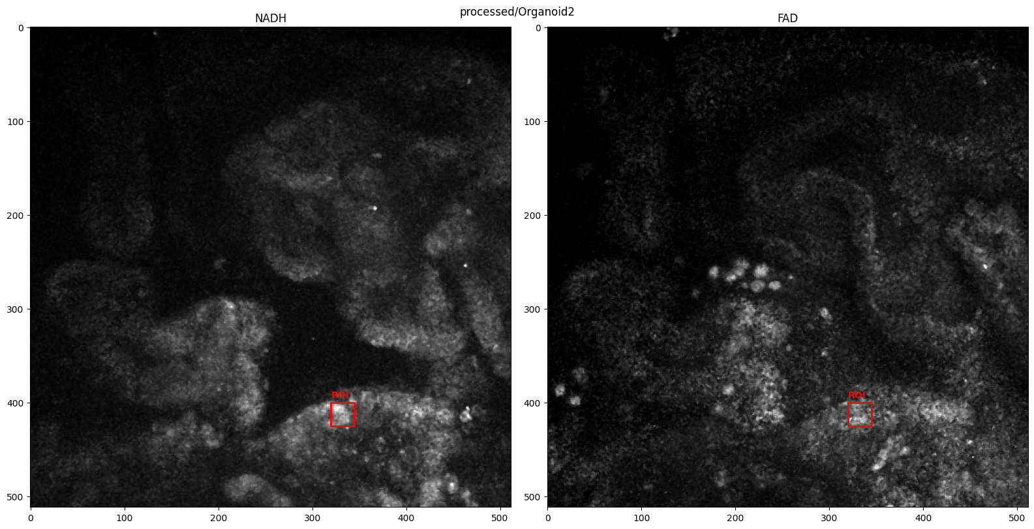
ROI 1

Slide 15
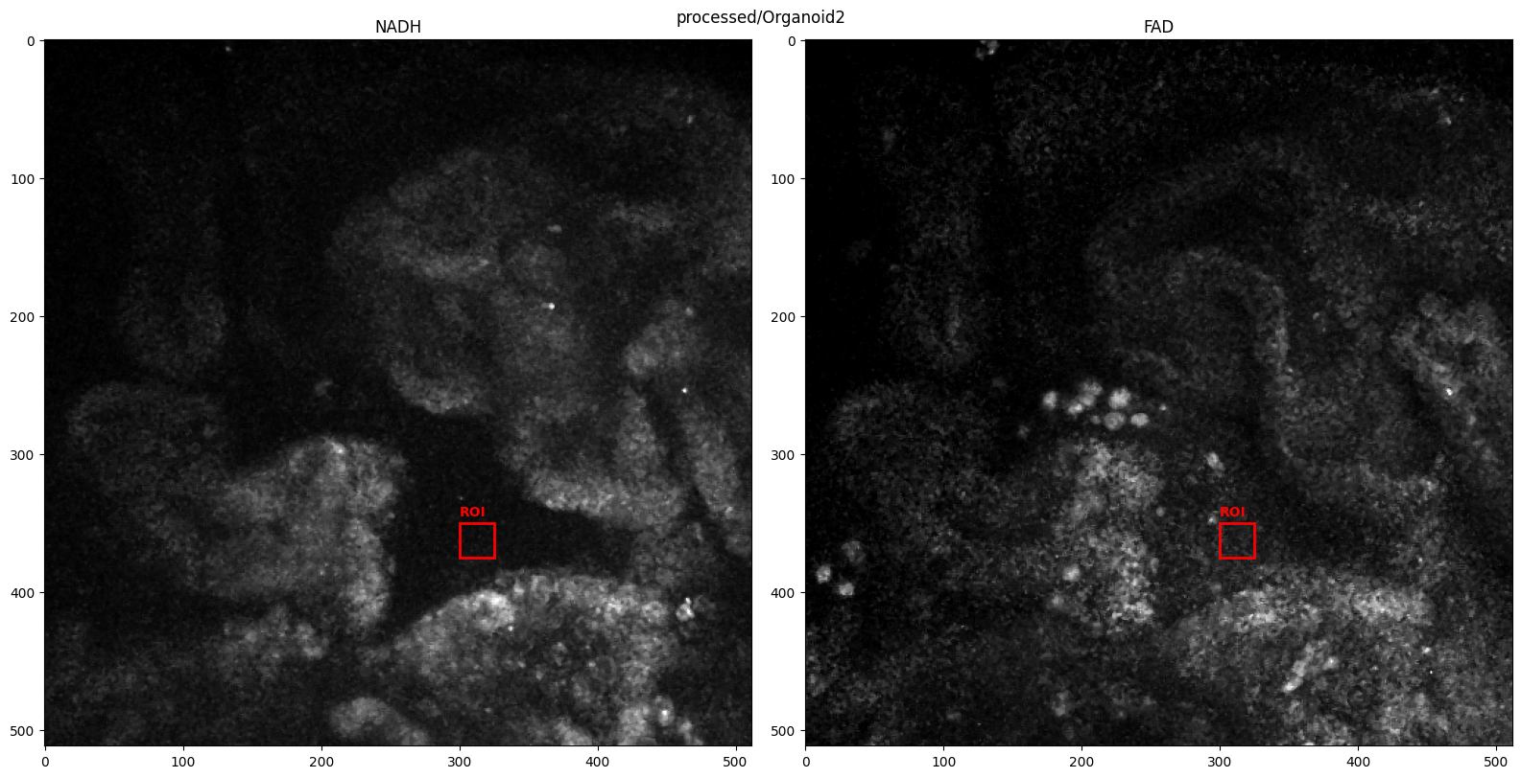
ROI 2

Slide 16
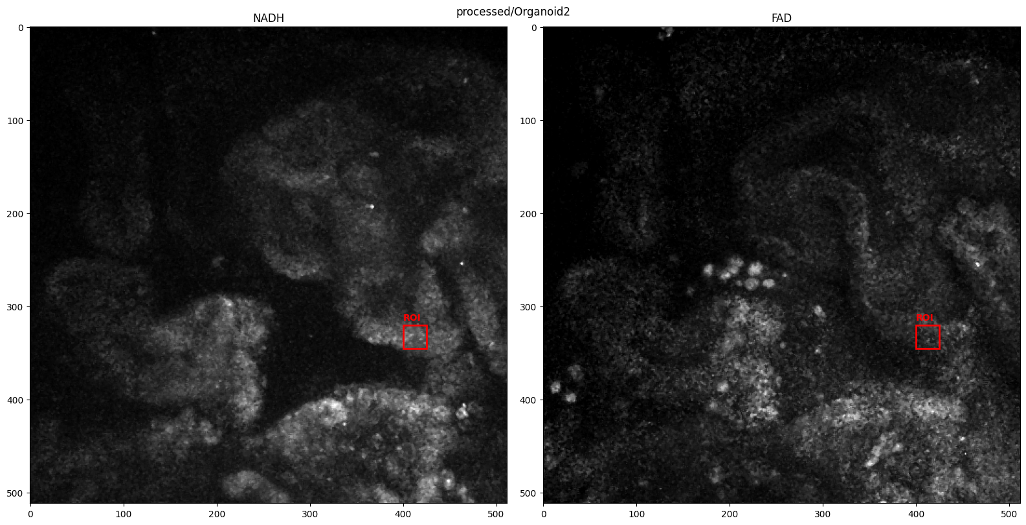
ROI 3

Slide 17
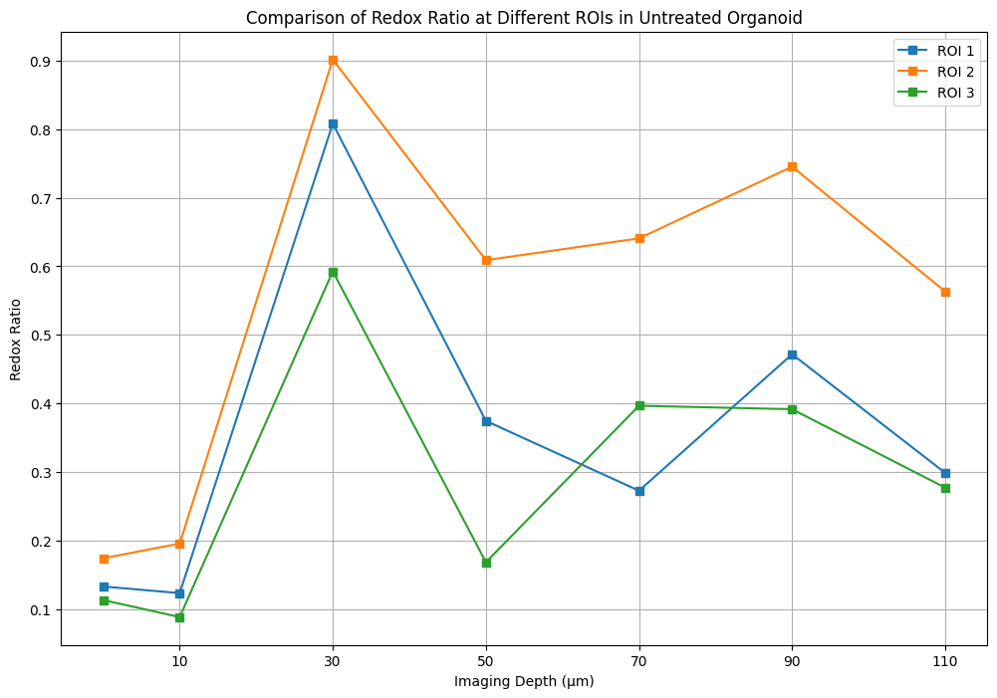
Redox Ratio variation with depth
Crypts have lower RR – intestinal stem cells rely more on glycolysis than oxidative phosphorylation to meet their energy demands
Villi have higher RR – Cells are differentiated and perform various function like nutrient absorption, rely more on oxidative phosphorylation
Lumen – Non-specific signal background autofluorescence due to cellular debris
Notes:
Quinton
Crypt cells include intestinal stem cells and proliferating progenitors, which rely more on glycolysis than OXPHOS to meet their energy demands. This results in a higher fraction of reduced NAD(P)H, leading to a lower redox ratio.

Slide 18
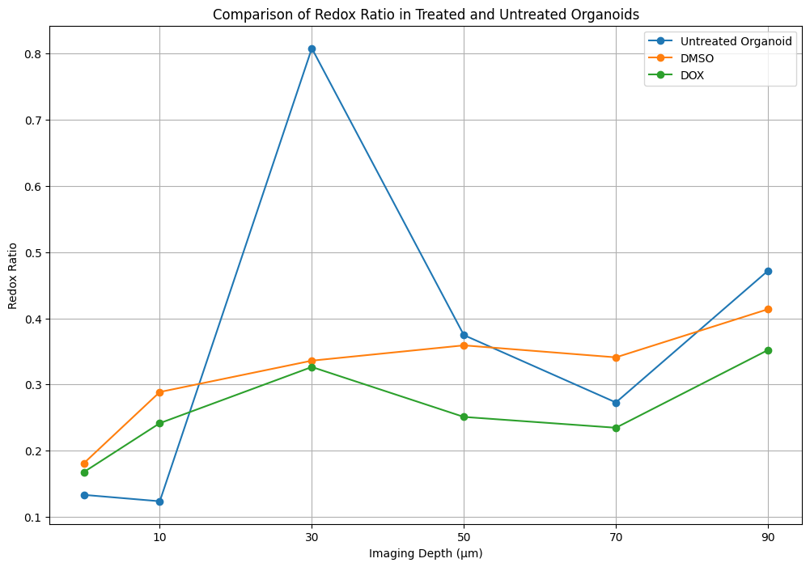
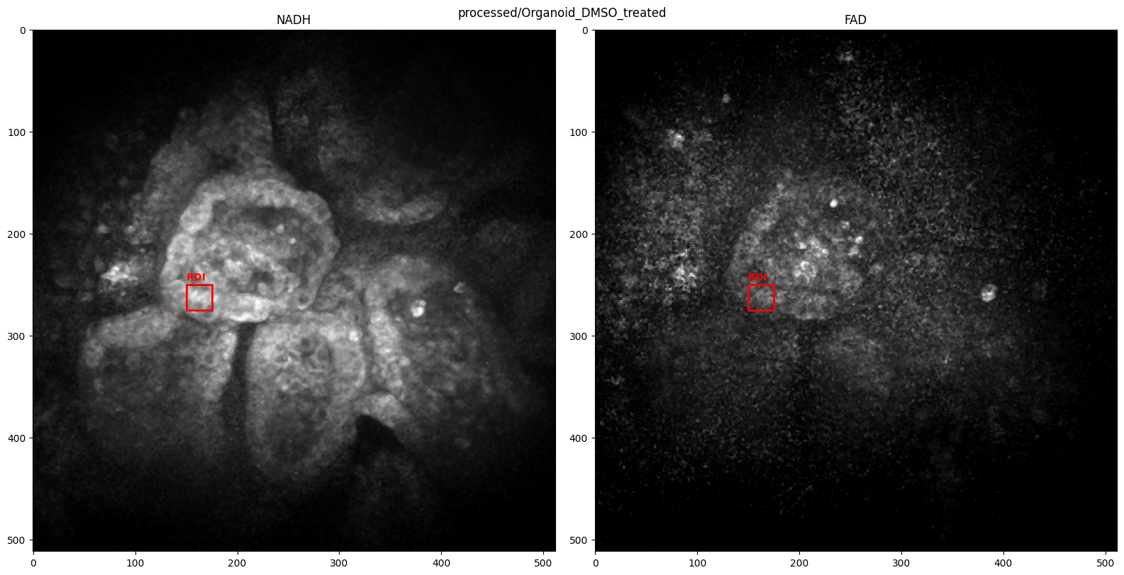
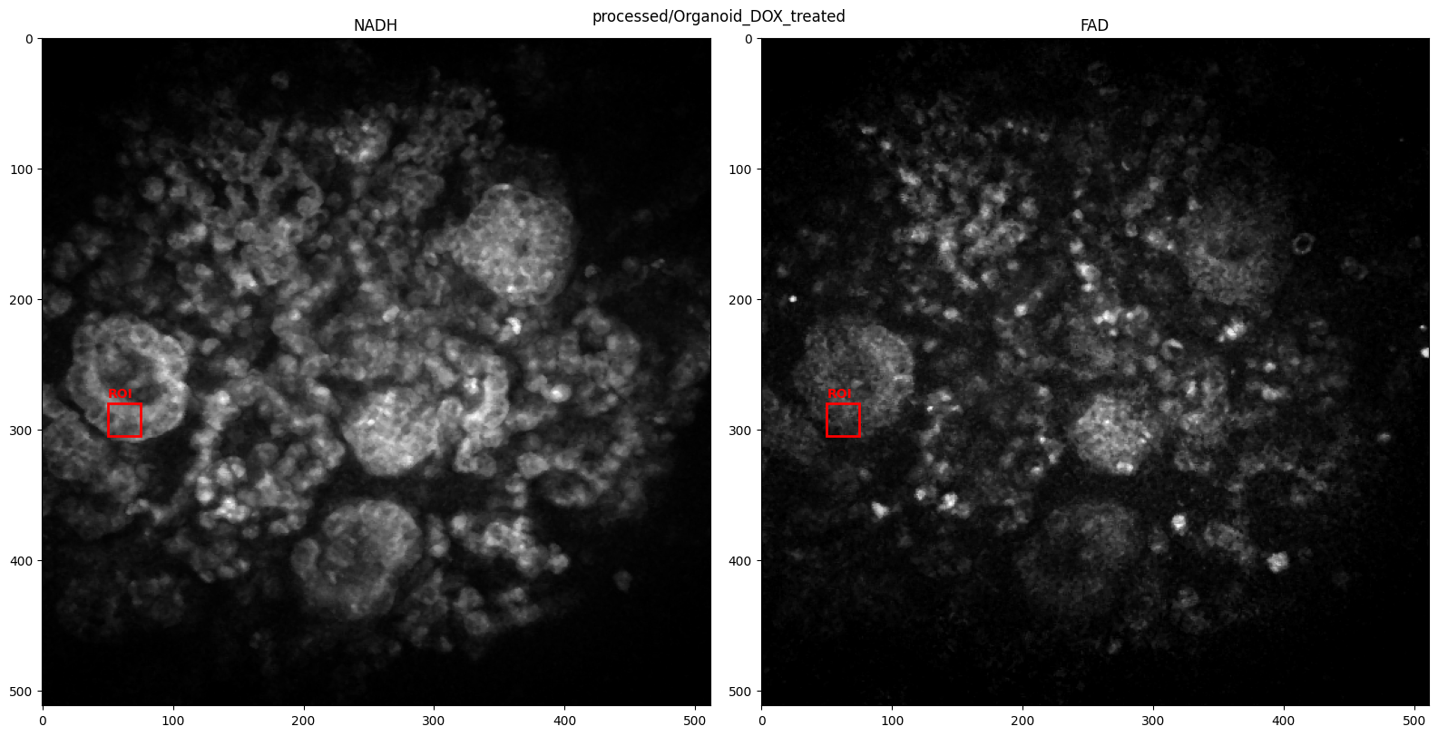
Redox Ratio variation with depth – comparison with treated
Max Intensity Projection of NADH and FAD channels
Untreated
DMSO treated
Overall Redox Ratio decrease which may indicate metabolic stress
Toxicity induced cell death could be seen as the signals are more fragmented
Higher cellular debris in the lumen might be the reason of artifactually slightly increased redox ratio
Loss of variability with treatment
DOX treated
Notes:
Quinton

Slide 19
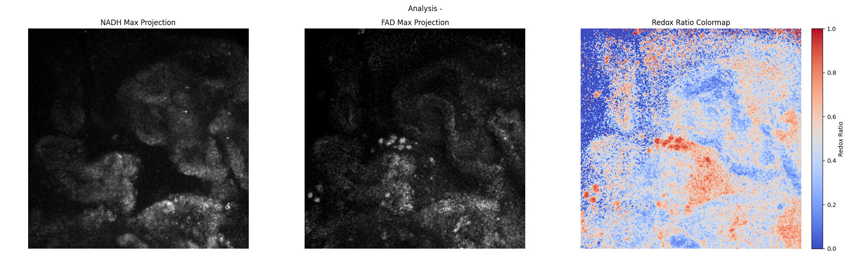
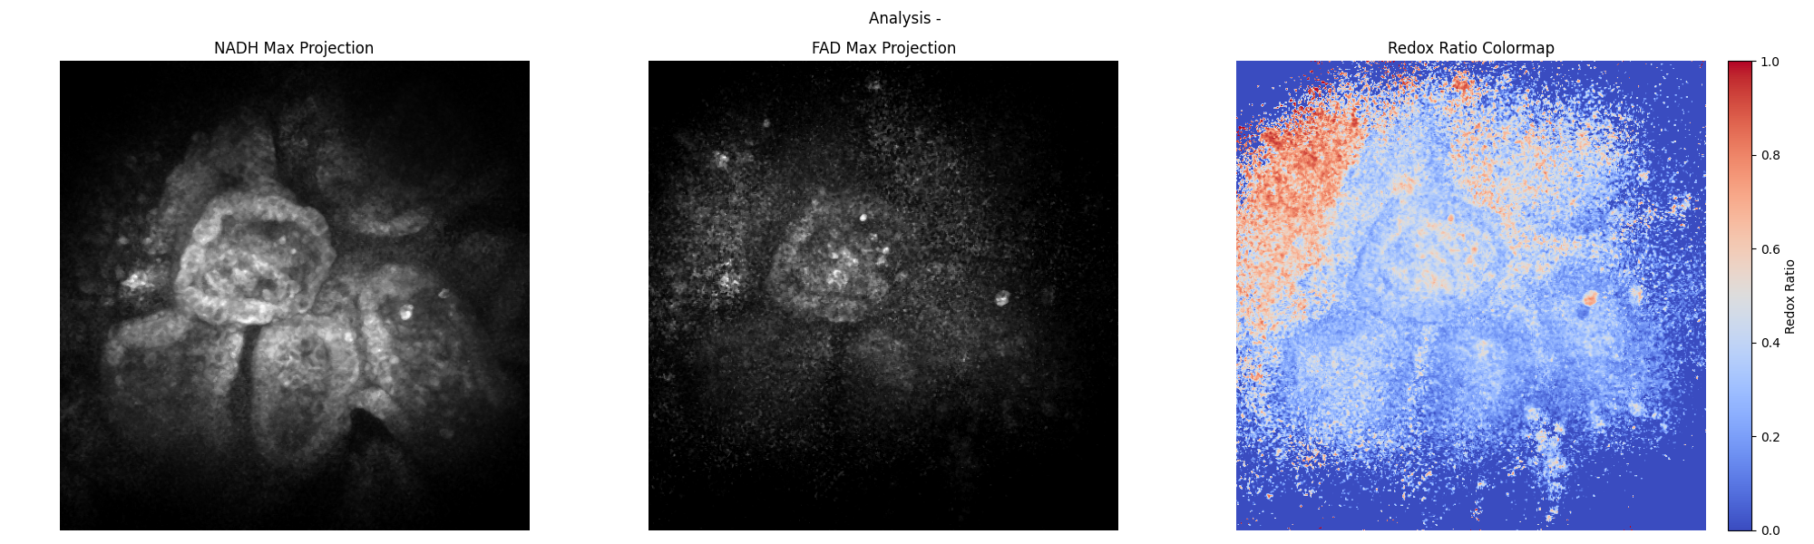
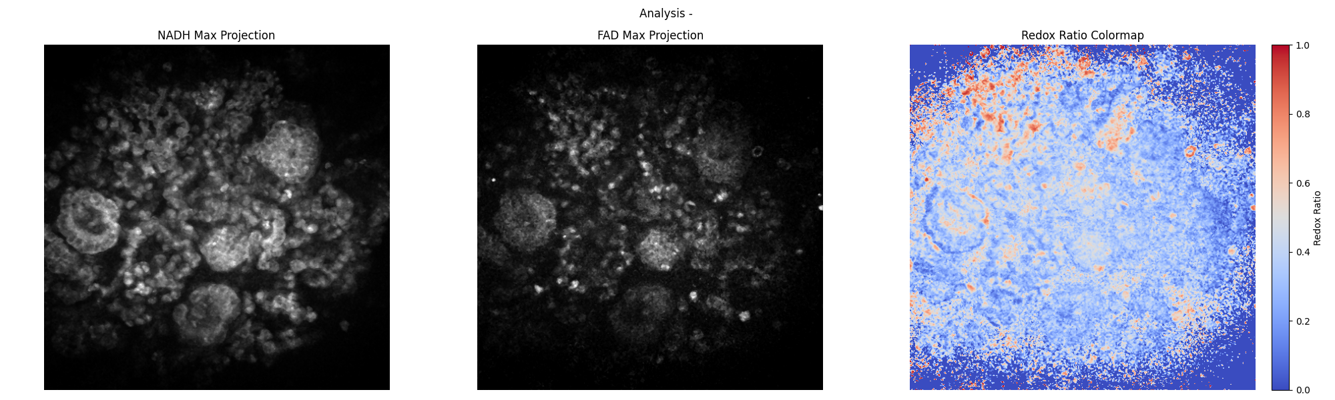
Heat Map for spatial distribution of Redox Ratio
Untreated
Heat map of Redox ratio calculated from NADH and FAD max intensity projections
DMSO
DOX
Notes:
Quinton

Slide 20
Conclusion and Future Directions
Redox-ratio is a powerful non-invasive method for assessing cellular metabolism and can be used to quantify the toxic effects of anti-cancer drug on healthy cells
Using a larger data set would give more accurate results
Collection efficiency is maximal at a depth in the range of a few scattering lengths depending on scattering and absorption parameters. For imaging depths beyond this point, the collection efficiency decreases in an exponential manner due to absorption
Currently we could go up to imaging depths of 110 microns - using methods like optical clearing, high contrast agents like gold nanorods can help in deeper penetration
Thank you! Questions?
Notes:
Olivia

